Slide 1
Schedule Snake
Presentation Pitch
Schedule your classes like never before!
Presented by :
Jay Noppone P, Matthew Munoz,
Baljinder Hothi, William Ng
7/1/24

Slide 2
Schedule Snake
Introducing Schedule Snake, the ultimate schedule builder system designed to revolutionize the way students and professors manage academic schedules. Effortlessly organize weekly schedules seamlessly. With Schedule Snake, academic scheduling becomes efficient, streamlined, and stress-free for everyone involved. Join us in transforming the academic experience with Schedule Snake!
Schedule Snake

Slide 3

Table of contents
01
What and Why?
02
How?
03
The Stack
04
Member Roles
What and why schedule snake?
How does schedule snake work?
The tech stack for schedule snake
The members of schedule snake

Slide 4
What And Why?
A service that offers a smooth process for educators to create and manage courses, and for students to easily apply for enrollment into those courses.
Schedule Snake will ensure swift enrollment into university courses free from delays and common registration issues that may stress both educators and students
Our product can be used by universities struggling with hosting an efficient schedule building software. Our data can be valuable considering that we have insights on current trending courses and fields students are studying.

Slide 5
But How?
User Journey Map
Users Sign up using their college credentials
Users view a list of classes at different times with differing professors
If the classes are not available, user is prompted to select new classes
Users can click enroll on their selected courses
Students can search for specific classes based on class ID or major
If the classes are available the user enrolls in said classes
The software checks to ensure the classes are available

Slide 6
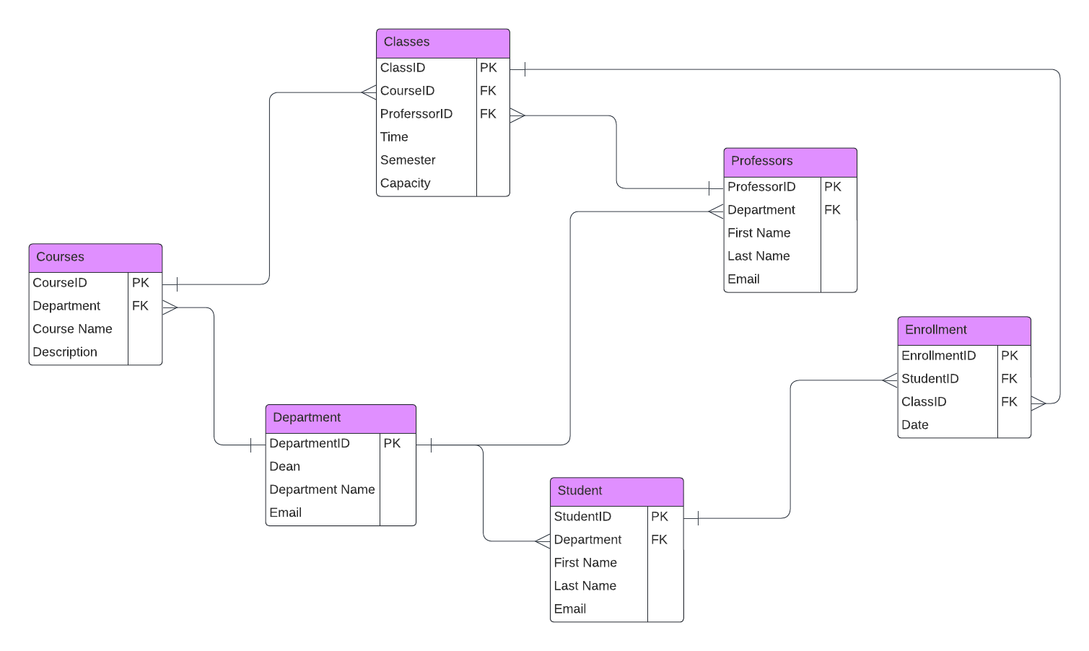
Data Model

Slide 7




The Stack
Frontend:
Next.JS
Tailwind CSS
Backend:
Node.JS
Database:
MySQL
Repository & Deployment:
Github
Docker

Slide 8
Member Roles
Front-End
UI/ UX
Back-End
Jinder
Matthew
William
Jay
Baljinder

Slide 9
Q&A
Q&A session
Thank you for listening to our presentation! - Presented by Jay, Baljinder, Matthew, & William

